Slide 1
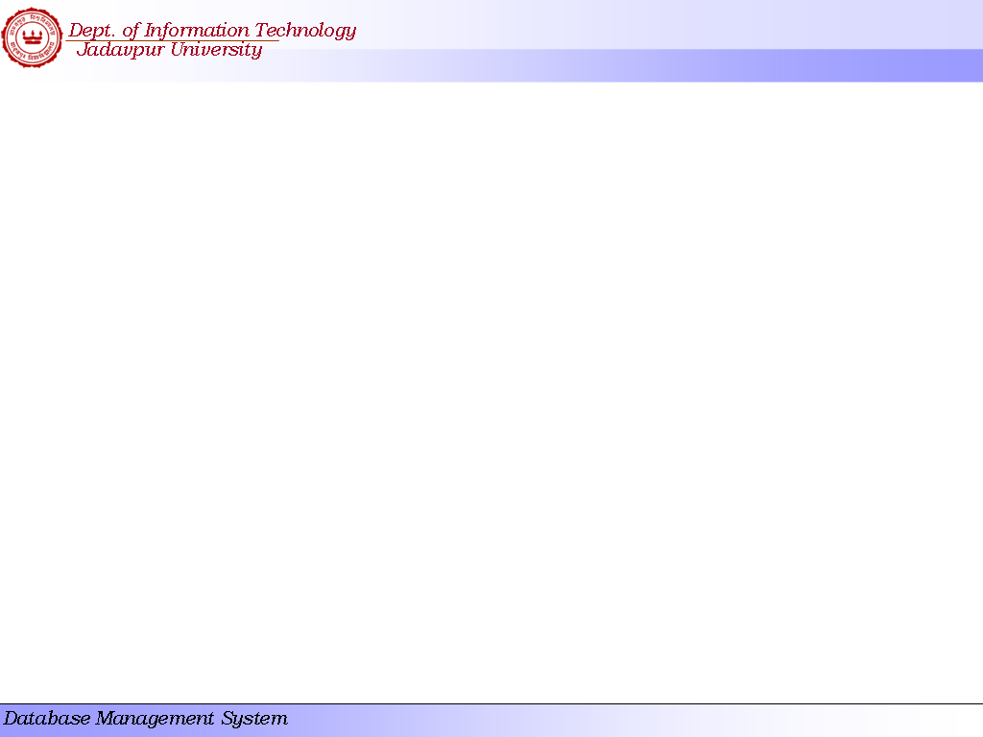
Transactions

Slide 2
Chapter Outline
Transaction Concept
Transaction State
Serializability
Testing for Serializability.

Slide 3
Introduction
Single-User System: At most one user at a time can use the system.
Multiuser System: Many users can access the system concurrently.
Concurrency
  Interleaved processing: concurrent execution of processes is interleaved in a single CPU
  Parallel processing: processes are concurrently executed in multiple CPUs.

Slide 4
Introduction
A Transaction is a unit of program execution that includes one or more access operations (read -retrieval, write - insert or update, delete).
Transaction boundaries: Begin and End transaction.
An application program may contain several transactions separated by the Begin and End transaction boundaries.

Slide 5
Transaction Concept
A transaction must see a consistent database.
During transaction execution the database may be temporarily inconsistent.
When the transaction completes successfully (is committed), the database must be consistent.
After a transaction commits, the changes it has made to the database persist, even if there are system failures.
Multiple transactions can execute in parallel.
Two main issues to deal with:
  Failures of various kinds, such as hardware failures and system crashes [recovery method]
  Concurrent execution of multiple transactions [concurrency control]

Slide 6
Introduction to Transaction Processing
Basic operations are read and write
  read_item(X): Reads a database item named X into a program variable. To simplify our notation, we assume that the program variable is also named X.
  write_item(X): Writes the value of program variable X into the database item named X.

Slide 7
Introduction to Transaction Processing
READ AND WRITE OPERATIONS:
Basic unit of data transfer from the disk to the computer main memory is one block. In general, a data item (what is read or written) will be the field of some record in the database, although it may be a larger unit such as a record or even a whole block.
read_item(X) command includes the following steps:
Find the address of the disk block that contains item X.
Copy that disk block into a buffer in main memory (if that disk block is not already in some main memory buffer).
Copy item X from the buffer to the program variable named X.

Slide 8
Introduction to Transaction Processing
READ AND WRITE OPERATIONS (cont.):
write_item(X) command includes the following steps:
Find the address of the disk block that contains item X.
Copy that disk block into a buffer in main memory (if that disk block is not already in some main memory buffer).
Copy item X from the program variable named X into its correct location in the buffer.
Store the updated block from the buffer back to disk (either immediately or at some later point in time).

Slide 9

Two sample transactions. (a) Transaction T₁.
(b) Transaction T₂.

Slide 10
Example of Fund Transfer
Transaction to transfer $50 from account A to account B:
  1. read(A)
  2. A := A – 50
  3. write(A)
  4. read(B)
  5. B := B + 50
  6. write(B)
---- if the transaction fails after step 3 and before step 6, the system should ensure that its updates are not reflected in the database, else an inconsistency will result.
---- the sum of A and B is unchanged by the execution of the transaction.

Slide 11
Example of Fund Transfer (Cont.)
---- if between steps 3 and 6, another transaction is allowed to access the partially updated database, it will see an inconsistent database (the sum A + B will be less than it should be).
  One solution, running transactions serially, that is one after the other.
  However, executing multiple transactions concurrently has significant benefits, as we will see later.
---- once the user has been notified that the transaction has completed (i.e., the transfer of the $50 has taken place), the updates to the database by the transaction must persist despite failures.

Slide 12
Introduction to Transaction Processing
Why Concurrency Control is needed:
The Lost Update Problem.
This occurs when two transactions that access the same database items have their operations interleaved in a way that makes the value of some database item incorrect.
The Temporary Update (or Dirty Read) Problem.
This occurs when one transaction updates a database item and then the transaction fails for some reason. The updated item is accessed by another transaction before it is changed back to its original value.

Slide 13
Introduction to Transaction Processing
Why Concurrency Control is needed (cont.):
The Incorrect Summary Problem .
If one transaction is calculating an aggregate summary function on a number of records while other transactions are updating some of these records, the aggregate function may calculate some values before they are updated and others after they are updated.

Slide 14
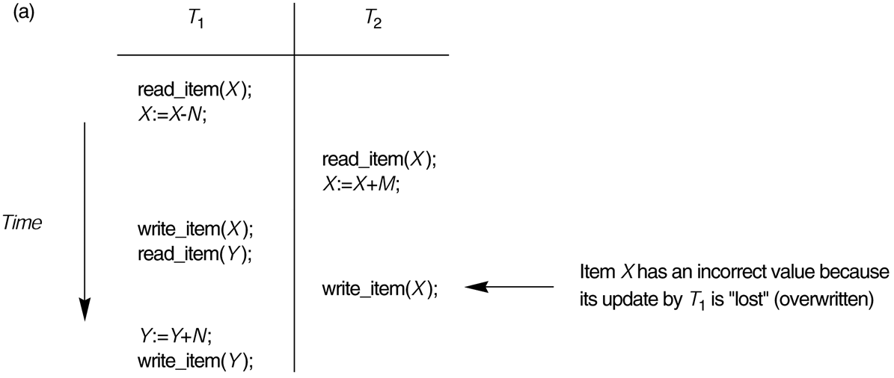
Some problems that occur when concurrent execution is uncontrolled. (a) The lost update problem.

Slide 15
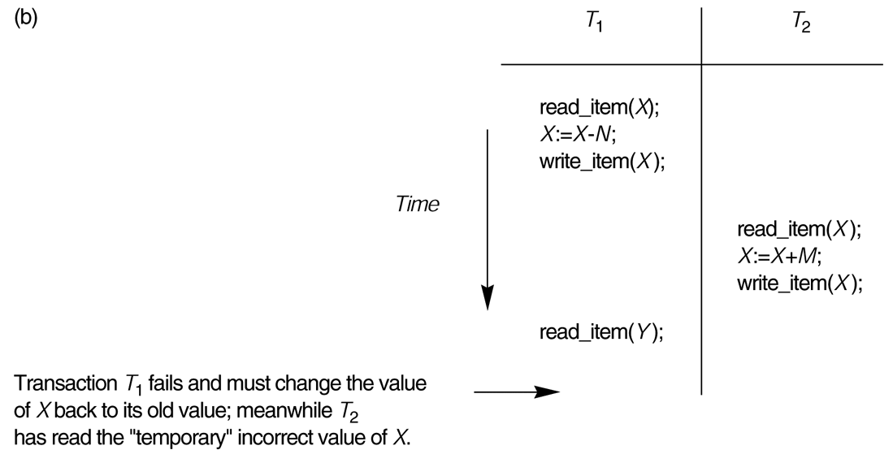
Some problems that occur when concurrent execution is uncontrolled. (b) The temporary update problem.

Slide 16
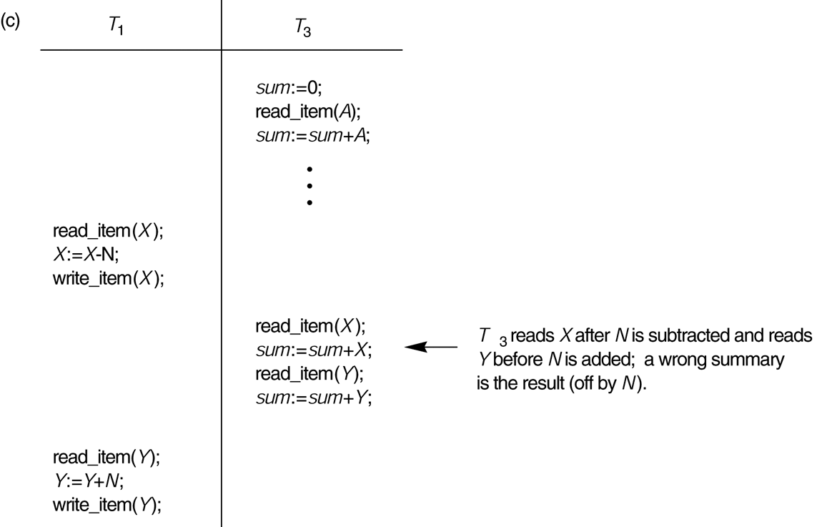
Some problems that occur when concurrent execution is uncontrolled. (c) The incorrect summary problem.

Slide 17
ACID Properties
Atomicity. Either all operations of the transaction are properly reflected in the database or none are.
Consistency. A correct execution of the transaction must take the database from one consistent state to another.
Isolation. Although multiple transactions may execute concurrently, each transaction must be unaware of other concurrently executing transactions. Intermediate transaction results must be hidden from other concurrently executed transactions.
  That is, for every pair of transactions T_{i} and T_{j}, it appears to T_{i} that either T_{j}, finished execution before T_{i} started, or T_{j} started execution after T_{i} finished.
Durability/Permanency. After a transaction completes successfully, the changes it has made to the database persist, even if there are system failures.

Slide 18
Transaction and System Concepts
A transaction is an atomic unit of work that is either completed in its entirety or not done at all. For recovery purposes, the system needs to keep track of when the transaction starts, terminates, and commits or aborts.
Transaction states:
Active: the initial state; the transaction stays in this state while it is executing.
Partially committed: after the final statement has been executed.
Committed: after successful completion.
Failed: after the discovery that normal execution can no longer proceed.
Terminated (or Aborted): after the transaction has been rolled back and the database restored to its state prior to the start of the transaction. Two options after it has been aborted:
  restart the transaction; can be done only if no internal logical error
  kill the transaction

Slide 19

Transaction State (Cont.)

Slide 20
Concurrent Executions
Multiple transactions are allowed to run concurrently in the system. Advantages are:
  increased processor and disk utilization, leading to better transaction throughput: one transaction can be using the CPU while another is reading from or writing to the disk
  reduced average response time for transactions: short transactions need not wait behind long ones.
Concurrency control schemes – mechanisms to achieve isolation; that is, to control the interaction among the concurrent transactions in order to prevent them from destroying the consistency of the database.

Slide 21
Transaction Schedule
When transaction are executed concurrently in an interleaved fashion.
A schedule S of n transactions T₁, T₂,…, T_{n}:
  All the instructions of the participating transactions must be present in S.
  The relative ordering of the instructions of each individual transaction must be preserved.
  However, the instructions of the different transactions may be in interleaving fashion.
A transaction that successfully completes its execution will have a commit instructions as the last statement (will be omitted if it is obvious).
A transaction that fails to successfully complete its execution will have an abort instructions as the last statement (will be omitted if it is obvious).

Slide 22

Schedule 1
Let T₁ transfer $50 from A to B, and T₂ transfer 10% of the balance from A to B.
A serial schedule in which T₁ is followed by T₂:

Slide 23

Schedule 2
A serial schedule where T₂ is followed by T₁

Slide 24

Schedule 3
Let T₁ and T₂ be the transactions defined previously. The following schedule is not a serial schedule, but it is equivalent to Schedule 1.
In Schedules 1, 2 and 3, the sum A + B is preserved.

Slide 25

Schedule 4
The following concurrent schedule does not preserve the value of (A + B).

Slide 26
Serializability
Basic Assumption – Each transaction preserves database consistency.
Thus serial execution of a set of transactions preserves database consistency.
Serial schedule: A schedule S is serial if, for every transaction T participating in the schedule, all the operations of T are executed consecutively in the schedule. Otherwise, the schedule is called nonserial schedule.
Serializable schedule: A schedule S is serializable if it is equivalent to some serial schedule of the same n transactions.

Slide 27
Serializability
Result equivalent: Two schedules are called result equivalent if they produce the same final state of the database.
A (possibly concurrent) schedule is serializable if it is equivalent to a serial schedule. Different forms of schedule equivalence give rise to the notions of:
  1. conflict serializability
  2. view serializability
We ignore operations other than read and write instructions, and we assume that transactions may perform arbitrary computations on data in local buffers in between reads and writes. Our simplified schedules consist of only read and write instructions.

Slide 28
Conflicting Instructions
Instructions l_{i} and l_{j} of transactions T_{i} and T_{j} respectively, conflict if and only if there exists some item Q accessed by both l_{i} and l_{j}, and at least one of these instructions wrote Q.
1. l_{i} = read(Q), l_{j} = read(Q). l_{i} and l_{j} don’t conflict.
2. l_{i} = read(Q), l_{j} = write(Q). They conflict.
3. l_{i} = write(Q), l_{j} = read(Q). They conflict
4. l_{i} = write(Q), l_{j} = write(Q). They conflict
Intuitively, a conflict between l_{i} and l_{j} forces a (logical) temporal order between them.
  If l_{i} and l_{j} are consecutive in a schedule and they do not conflict, their results would remain the same even if they had been interchanged in the schedule.

Slide 29
Conflicting Serializable
Conflict equivalent: Two schedules are said to be conflict equivalent if the order of any two conflicting operations is the same in both schedules.
Conflict serializable: A schedule S is said to be conflict serializable if it is conflict equivalent to some serial schedule S’.

Slide 30


Conflict Serializability (Cont.)
Schedule 3 can be transformed into Schedule 6, a serial schedule where T₂ follows T₁, by series of swaps of non-conflicting instructions.
  Therefore Schedule 3 is conflict serializable.
Schedule 3
Schedule 6

Slide 31

Conflict Serializability (Cont.)
Example of a schedule that is not conflict serializable:
We are unable to swap instructions in the above schedule to obtain either the serial schedule < T₃, T₄ >, or the serial schedule < T₄, T₃ >.

Slide 32
View Serializability
Let S and S´ be two schedules with the same set of transactions. S and S´ are view equivalent if the following three conditions are met:
  1. For each data item Q, if transaction T_{i} reads the initial value of Q in schedule S, then transaction T_{i} must, in schedule S´, also read the initial value of Q.
  2. For each data item Q if transaction T_{i} executes read(Q) in schedule S, and that value was produced by transaction T_{j} (if any), then transaction T_{i} must in schedule S´ also read the value of Q that was produced by transaction T_{j} .
  3. For each data item Q, the transaction (if any) that performs the final write(Q) operation in schedule S must perform the final write(Q) operation in schedule S´.
As can be seen, view equivalence is also based purely on reads and writes alone.

Slide 33

View Serializability (Cont.)
A schedule S is view serializable it is view equivalent to a serial schedule.
Every conflict serializable schedule is also view serializable.
Conflict serializability is stricter than view serializability. With unconstrained write (or blind write), a schedule that is view serializable is not necessarily conflict serialiable.
Below is a schedule which is view-serializable but not conflict serializable.
What serial schedule is above equivalent to?
Every view serializable schedule that is not conflict serializable has blind writes.

Slide 34
Testing for Serializability
Testing for conflict serializability
Algorithm
Looks at only read_Item (X) and write_Item (X) operations
Constructs a precedence graph (serialization graph) - a graph with directed edges
An edge is created from T_{i} to T_{j} if one of the operations in T_{i} appears before a conflicting operation in T_{j}
The schedule is serializable if and only if the precedence graph has no cycles.

Slide 35
Example Schedule (Schedule A) + Precedence Graph
T₁ T₂ T₃ T₄ T₅
read(X)
read(Y)
read(Z)
read(V)
read(W)
read(W)
read(Y)
write(Y)
write(Z)
read(U)
read(Y)
write(Y)
read(Z)
write(Z)
read(U)
write(U)
T₁
T₂
T₄
T₃

Slide 36

Test for Conflict Serializability
A schedule is conflict serializable if and only if its precedence graph is acyclic.
Cycle-detection algorithms exist which take order n² time, where n is the number of vertices in the graph.
  (Better algorithms take order n + e where e is the number of edges.)
If precedence graph is acyclic, the serializability order can be obtained by a topological sorting of the graph.
  This is a linear order consistent with the partial order of the graph.
  For example, a serializability order for Schedule A would be
  T₅ → T₁ → T₃ → T₂ → T₄
    Are there others?

Slide 37
Test for View Serializability
The precedence graph test for conflict serializability cannot be used directly to test for view serializability.
  Extension to test for view serializability has cost exponential in the size of the precedence graph.
The problem of checking if a schedule is view serializable falls in the class of NP-complete problems.
  Thus existence of an efficient algorithm is extremely unlikely.
However practical algorithms that just check some sufficient conditions for view serializability can still be used.

Slide 38
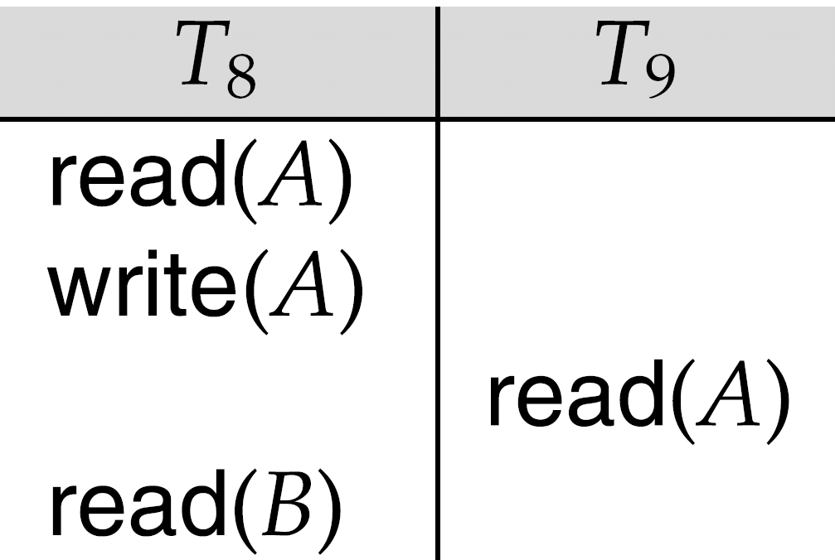
Recoverable Schedules
Need to address the effect of transaction failures on concurrently
running transactions.
Recoverable schedule — if a transaction T_{j} reads a data item previously written by a transaction T_{i} , then the commit operation of T_{i} appears before the commit operation of T_{j}.
The following schedule (Schedule 11) is not recoverable if T₉ commits immediately after the read
If T₈ should abort, T₉ would have read (and possibly shown to the user) an inconsistent database state. Hence, database must ensure that schedules are recoverable.

Slide 39

Cascading Rollbacks
Cascading rollback – a single transaction failure leads to a series of transaction rollbacks. Consider the following schedule where none of the transactions has yet committed (so the schedule is recoverable)
If T₁₀ fails, T₁₁ and T₁₂ must also be rolled back.
Can lead to the undoing of a significant amount of work

Slide 40
Cascadeless Schedules
Cascadeless schedules — cascading rollbacks cannot occur; for each pair of transactions T_{i} and T_{j} such that T_{j} reads a data item previously written by T_{i}, the commit operation of T_{i} appears before the read operation of T_{j}.
Every cascadeless schedule is also recoverable
It is desirable to restrict the schedules to those that are cascadeless

Slide 41
Concurrency Control
A database must provide a mechanism that will ensure that all possible schedules are
  either conflict or view serializable, and
  are recoverable and preferably cascadeless
A policy in which only one transaction can execute at a time generates serial schedules, but provides a poor degree of concurrency
  Are serial schedules recoverable/cascadeless?
Testing a schedule for serializability after it has executed is a little too late!
Goal – to develop concurrency control protocols that will assure serializability.

Slide 42
Concurrency Control vs. Serializability Tests
Concurrency-control protocols allow concurrent schedules, but ensure that the schedules are conflict/view serializable, and are recoverable and cascadeless.
Concurrency control protocols generally do not examine the precedence graph as it is being created
  Instead a protocol imposes a discipline that avoids nonseralizable schedules.
Different concurrency control protocols provide different tradeoffs between the amount of concurrency they allow and the amount of overhead that they incur.
Tests for serializability help us understand why a concurrency control protocol is correct.

